Slide 1
Osher Lifelong Learning Institute, Fall 2023
Contemporary Economic Policy
University of Southern Maine
January/February 2024
Jon Haveman, Ph.D.
National Economic Education Delegation

Slide 2
National Economic Education Delegation
Vision
  One day, the public discussion of policy issues will be grounded in an accurate perception of the underlying economic principles and data.
Mission
  NEED unites the skills and knowledge of a vast network of professional economists to promote understanding of the economics of policy issues in the United States.
NEED Presentations
  Are nonpartisan and intended to reflect the consensus of the economics profession.

Slide 3
Who Are We?
Honorary Board: 54 members
  2 Fed Chairs: Janet Yellen, Ben Bernanke
  6 Chairs Council of Economic Advisers
    Furman (D), Rosen (R), Bernanke (R), Yellen (D), Tyson (D), Goolsbee (D)
  3 Nobel Prize Winners
    Akerlof, Smith, Maskin
Delegates: 652+ members
  At all levels of academia and some in government service
  All have a Ph.D. in economics
  Crowdsource slide decks
  Give presentations
Global Partners: 48 Ph.D. Economists
  Aid in slide deck development

Slide 4


Where Are We?

Slide 5
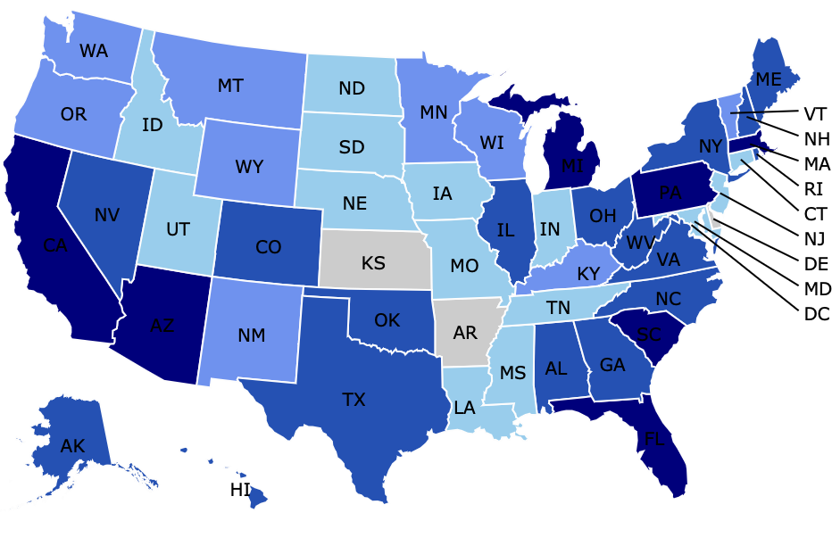
Where Have we Given Talks?

Slide 6
Available NEED Topics Include:
US Economy
Healthcare Economics
Climate Change
Economic Inequality
Economic Mobility
Trade and Globalization
Minimum Wages
Immigration Economics
Housing Policy
Federal Budgets
Federal Debt
Black-White Wealth Gap
Autonomous Vehicles
US Social Policy

Slide 7
Course Outline
Contemporary Economic Policy
  Week 1 (1/09): Economic Update (Geoffrey Woglom Amherst College)
  Week 2 (1/16): Climate Change Economics (Sarah Jacobson, Williams College))
  Week 3 (1/23): Federal Debt and Deficits (Brian Peterson), LaGrange College))
  Week 4 (1/30): International Institutions (Alan Deardorff U of Michigan)
  Week 5 (2/6): Monetary Policy and Inflation (Geoffrey Woglom)
  Week 5 (2/13): TBD

Slide 8


Greenhouse Gas Emissions 1990-2019
Source: IPCC
Notes:
https://www.ipcc.ch/report/ar6/wg3/ Summary for Policymakers Figure SPM.1

Slide 9
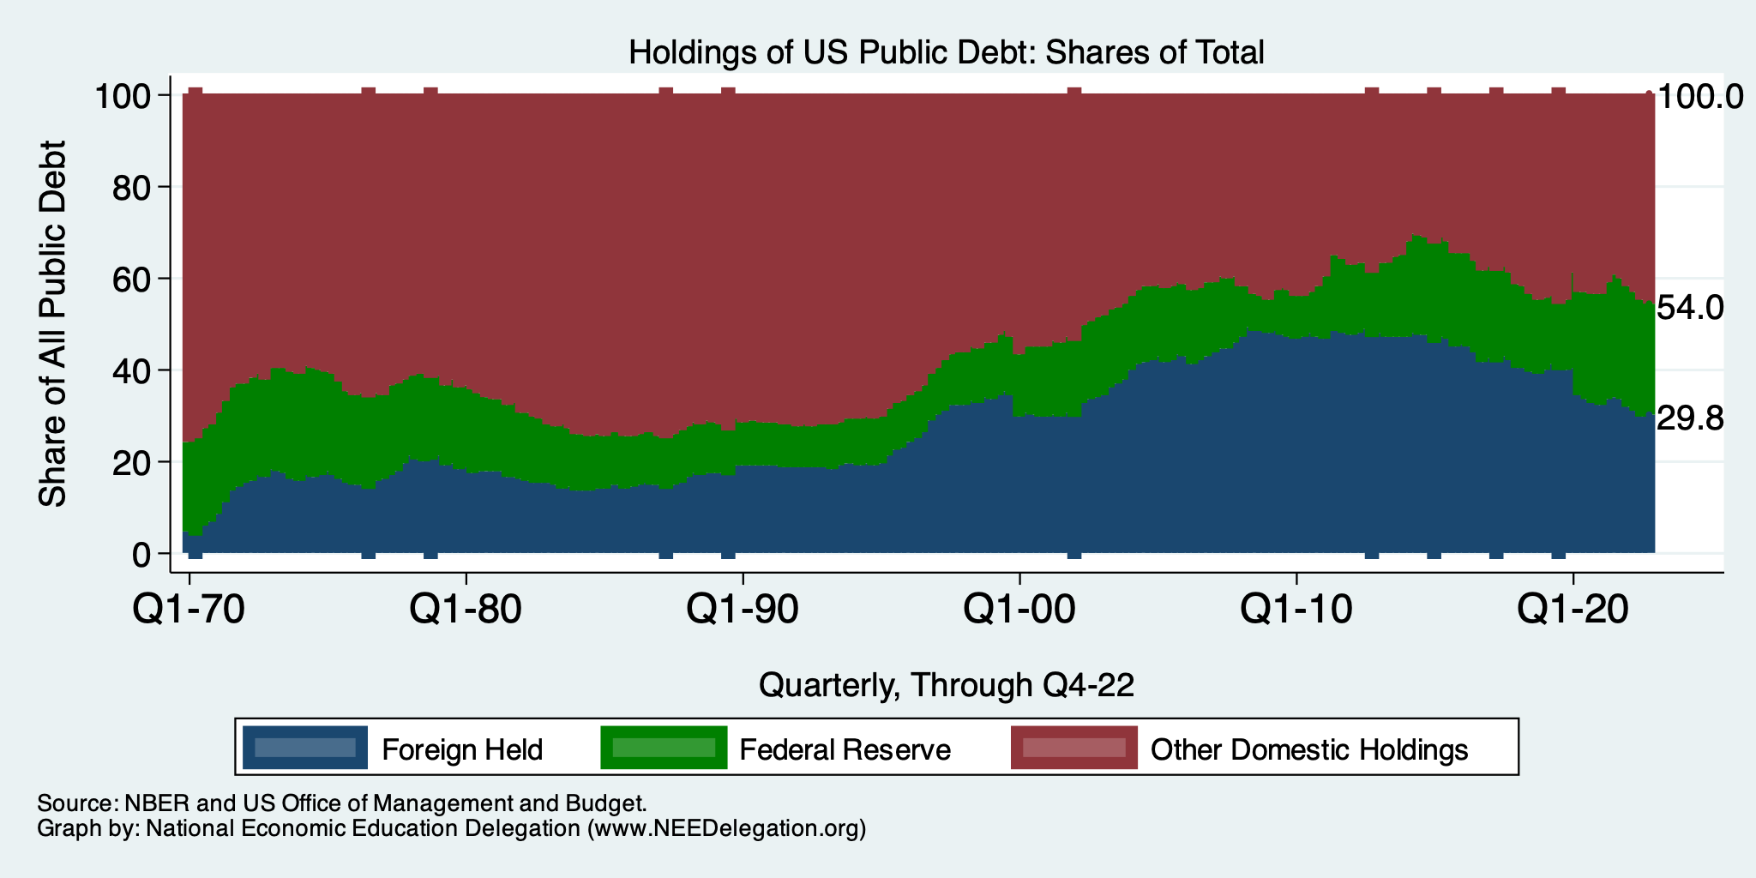
Trends in US Debt Over Time
2020, Q1: Other Domestic: 46.0%
Federal Reserve: 24.2%
Foreign: 29.8%

Slide 10

Main Economic Institutions
Notes:
https://sbhshgovapmacro.wordpress.com/2011/06/02/international-institutions/

Slide 11
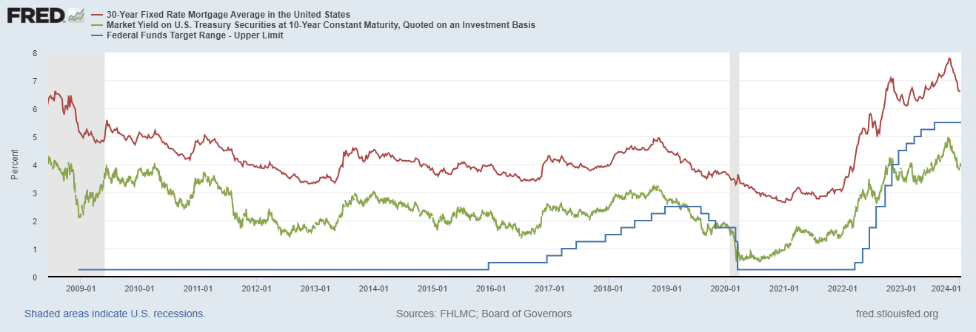
The Fed Affects the Economy Via Interest Rates

Slide 12
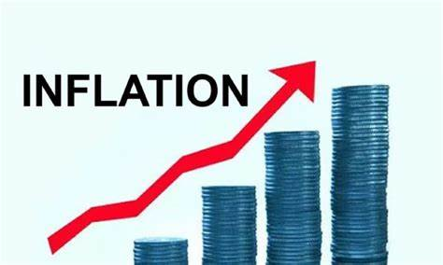
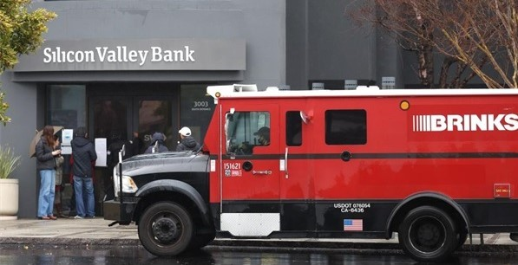
US Economy: Update
Geoffrey Woglom,
Professor of Economics
Amherst College, emeritus
January 8, 2024

Slide 13
Credits and Disclaimer
This slide deck was authored by:
  Jon D. Haveman, NEED
  Scott Baier, Clemson University
  Geoffrey Woglom, Amherst College (Emeritus)
  Brian Dombeck, Lewis & Clark College
  Doris Geide-Stevenson, Weber State
Disclaimer
  NEED presentations are designed to be nonpartisan.
  It is, however, inevitable that the presenter will be asked for and will provide their own views.
  Such views are those of the presenter and not necessarily those of the National Economic Education Delegation (NEED).

Slide 14
Outline for the Talk
Summary of the state of the macroeconomy.
The Effect of M&F policies on the recovery.
Explain why there was a major change in the outlook on 11/1.
Describe an unprecedented monetary policy achievement that may be unfolding.

Slide 15
Gross Domestic Product
Consumption | 67.8%
Investment | 17.7%
Exports | 11.0%
Imports | -13.8%
Government | 17.3%
GDP | 100.0%

Slide 16
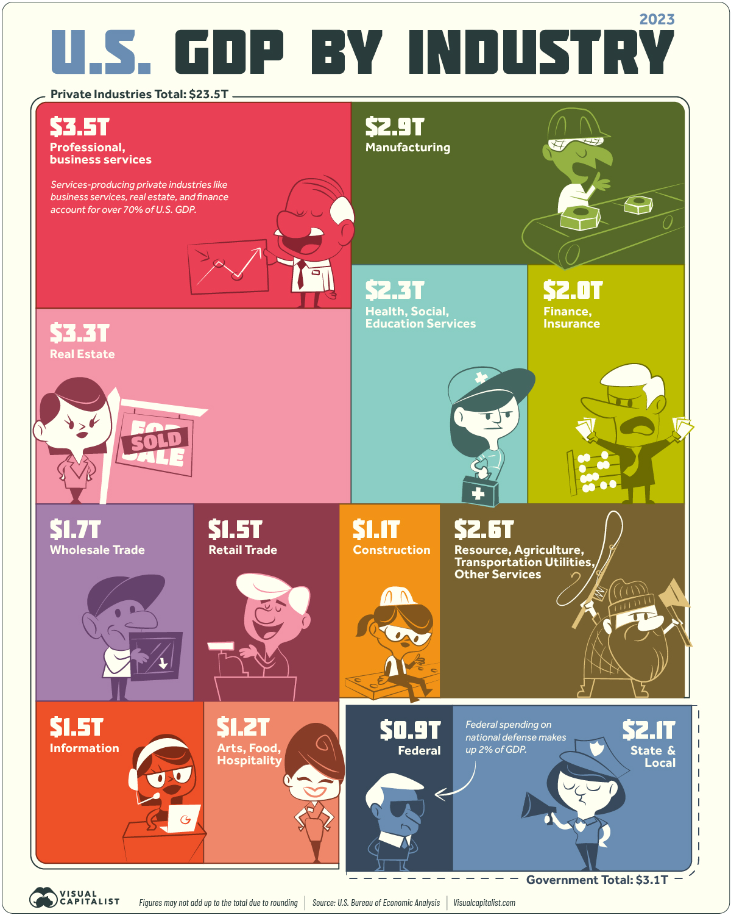
Different Breakdown

Slide 17
The Size of the World Economies
https://www.visualcapitalist.com/visualizing-the-105-trillion-world-economy-in-one-chart/

Slide 18
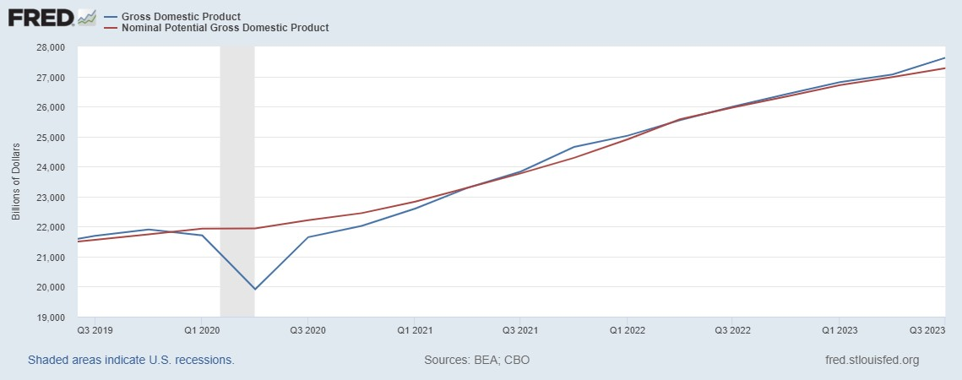
GDP and ‘Potential’ during the Recovery
Grey bars are recessions
Source: Fred, St Louis Fed

Slide 19
Unemployment is Near Record Lows

Slide 20
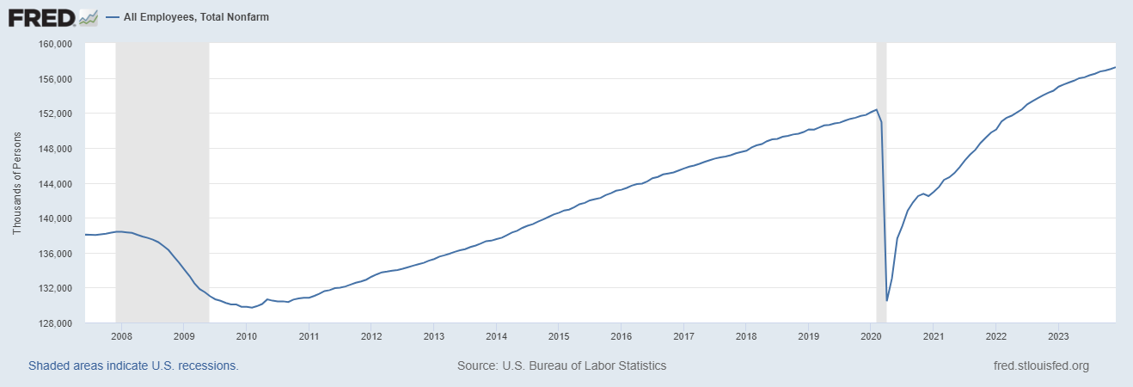
Where Have All the Workers Gone?
Notes:
Largely explained by baby boomer retirements and a little excess retirements due to COVID

Slide 21
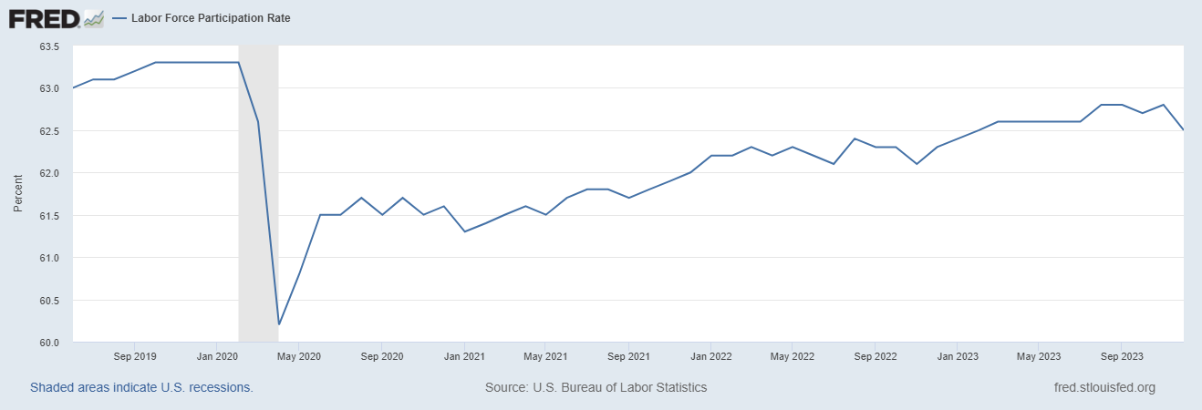
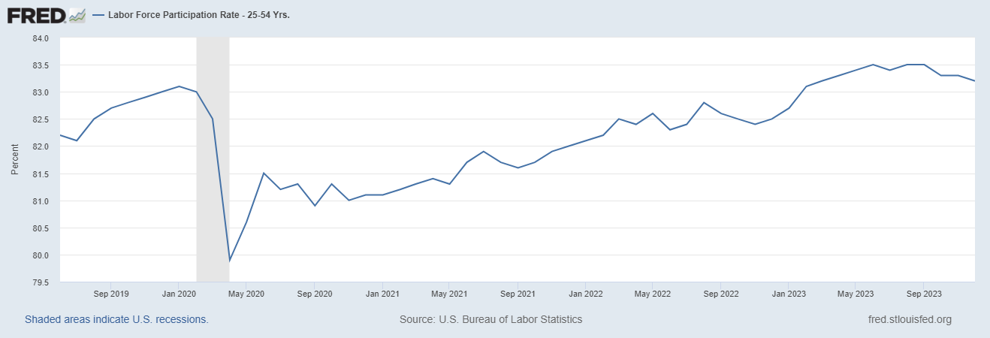
The Great Resignation?
Notes:
CBO Jan 2020 projections: LF, 62.5, vs 62.6; Total employment; 154.8 million vs actual 155.6. Civilian Labor Force; 160 vs 166.7

Slide 22
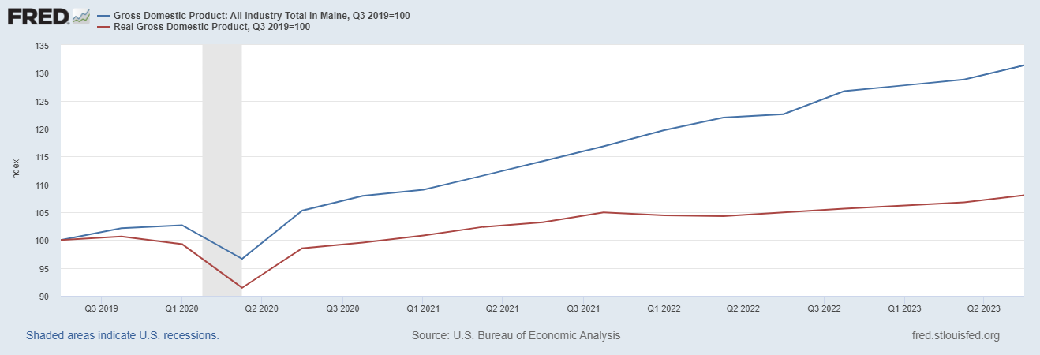
How is the Maine Economy Doing?
Gangbusters!

Slide 23
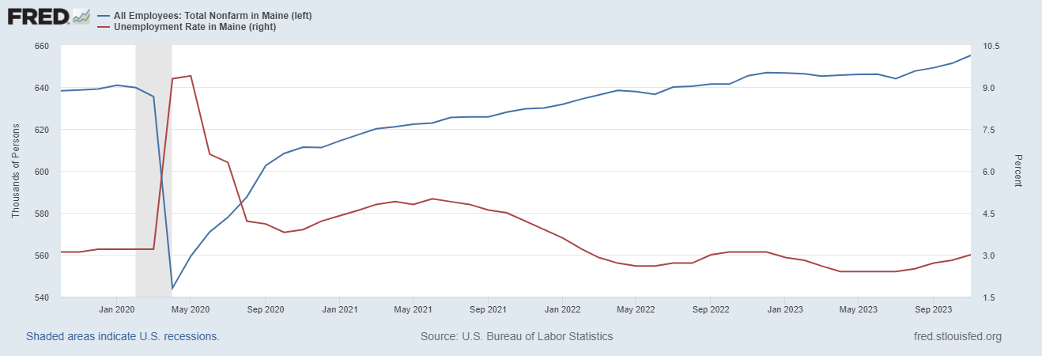
Labor Market in Maine

Slide 24
Overall Good News on the Real Side
GDP is very close to its potential.
The labor market as measured by the unemployment rate is fully recovered.
There was no apparent Great Resignation
But there is also a nominal side: interest rates, asset prices, inflation and wages.
News isn’t so good, but is getting better.

Slide 25
Interest Rates: Era of Falling Rates Over?
Notes:
Fed policy rate 4.5 to 4.25. Concerns with inflation

Slide 26
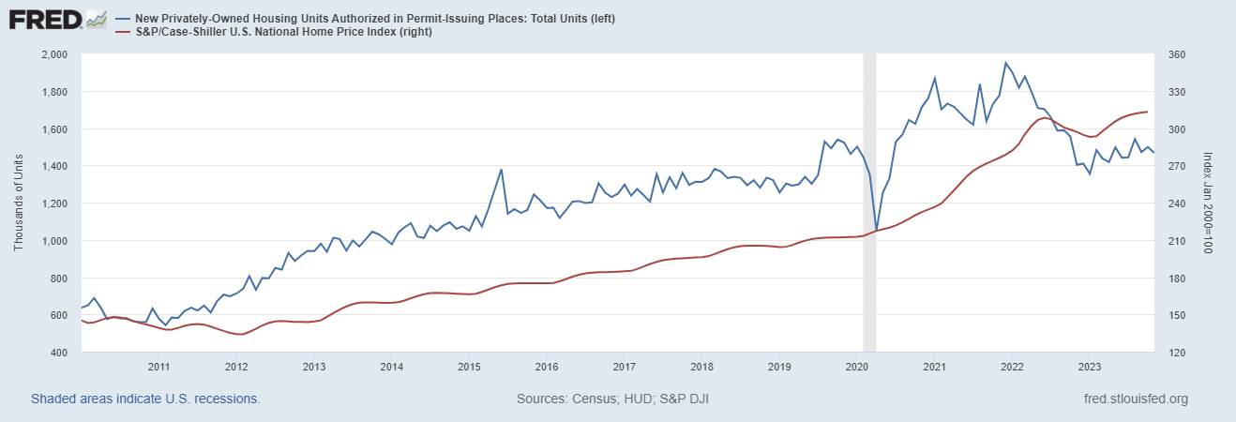
Mortgage Rates are Having an Effect ?

Slide 27
National Housing Market and Closer to Home
https://www.zillow.com/research/data/

Slide 28
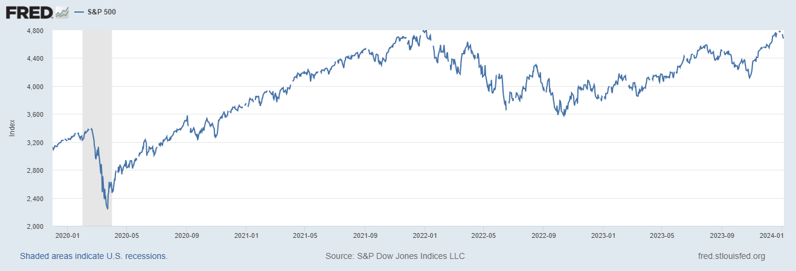
Stock Prices: Fear Giving Way to Greed?
Notes:
Since the end of 2021, lost almost 15%

Slide 29
Inflation during the Recovery (CPI)
Notes:
August CPI yoy 8.3% down from 8.5 and Core 6.3 up from 6.3 in JUly

Slide 30
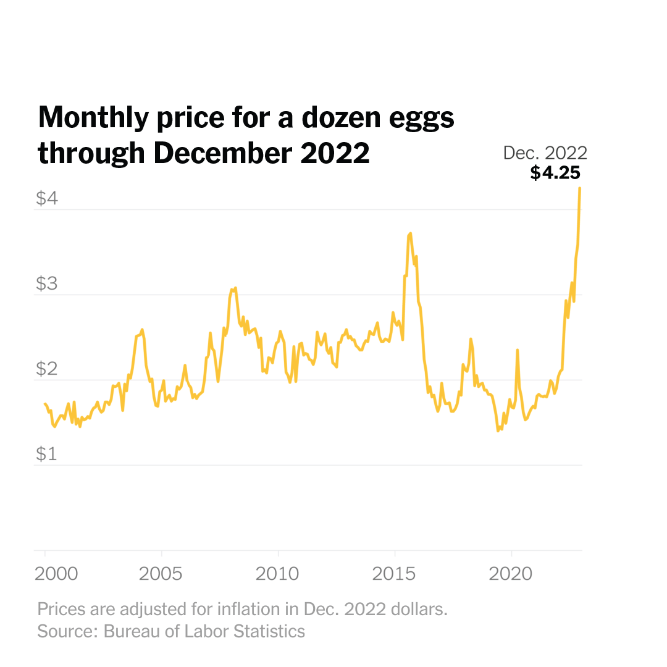
Uses of Inflation Measures
Two Reasons for Measuring Recent Inflation:
What has happened to the Cost of Living?
What is likely to happen to inflation over the next 12-18 months?

Slide 31
Fed’s Measure (PCE)
Fed Doesn’t React until 3/2022
Looks Promising?

Slide 32
What is Special about Measuring Over 1 Year?

Slide 33
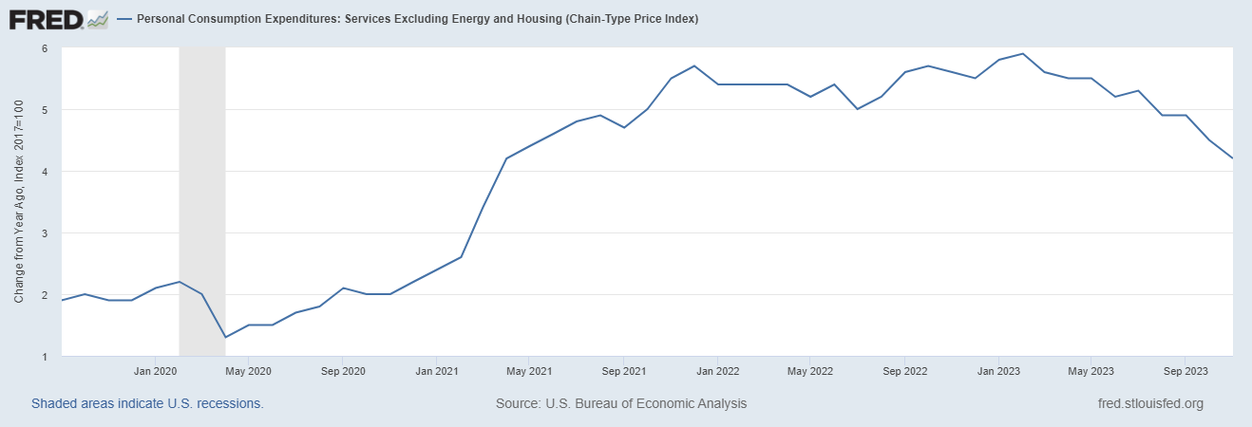
Measuring “Underlying” Inflation
Super Core

Slide 34
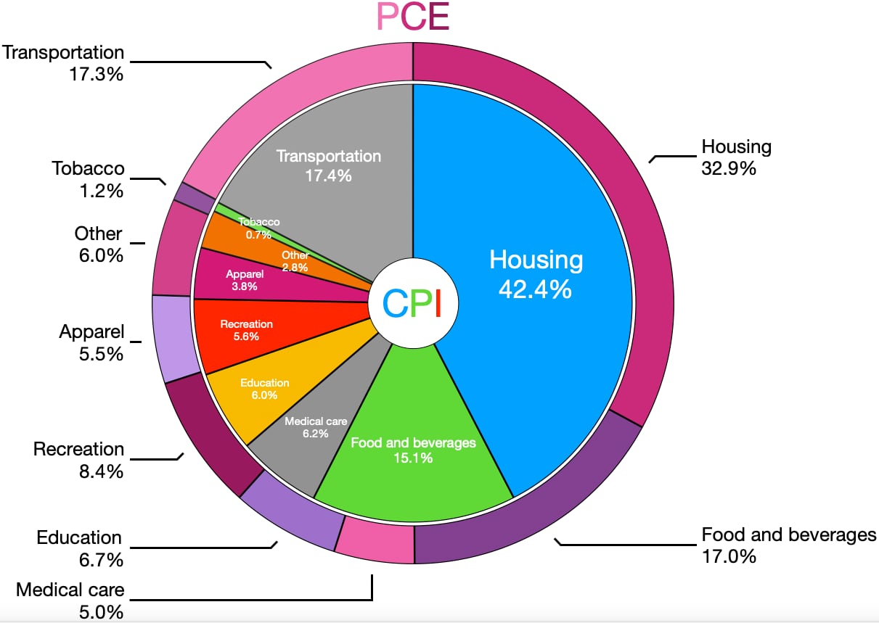
CPI vs. PCE: Differences
CPI tends to be higher (Nov):
CPI, 3.1%
PCE, 3.4%
Core CPI, 4.0%
Core PCE, 3.2%.
Typically more like 0.5 % pts.
https://en.wikipedia.org/wiki/Personal_consumption_expenditures_price_index#

Slide 35
Rents Paid versus Asking Rents

Slide 36
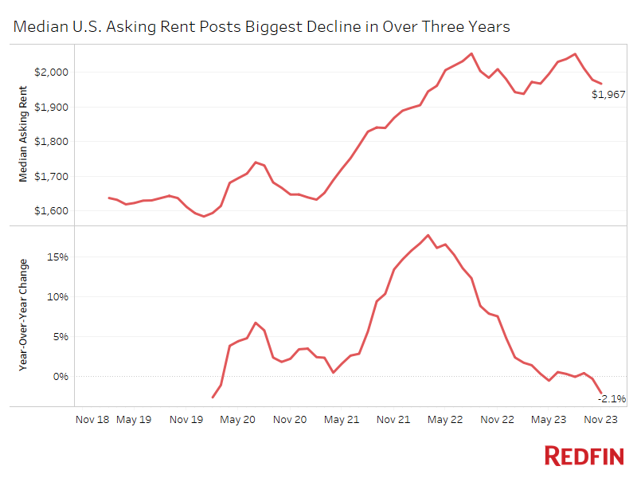
Even Better News?

Slide 37
Wages Haven’t Kept Pace with Inflation, Yet
Notes:
But, note that low wage workers are doing relatively the best

Slide 38
The “Nominal” Side
Inflation: There is still work to be done, but things are looking much better.

Slide 39
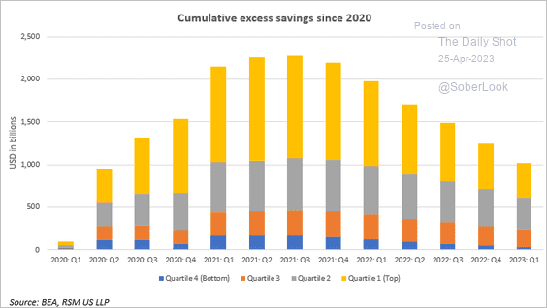
Policy Effects: Fiscal
2020-2021: massive stimulus, $4.6t: Cares Act, 3 rounds of stimulus checks, expanded unemployment benefits, Payroll Protection Loans.

Slide 40
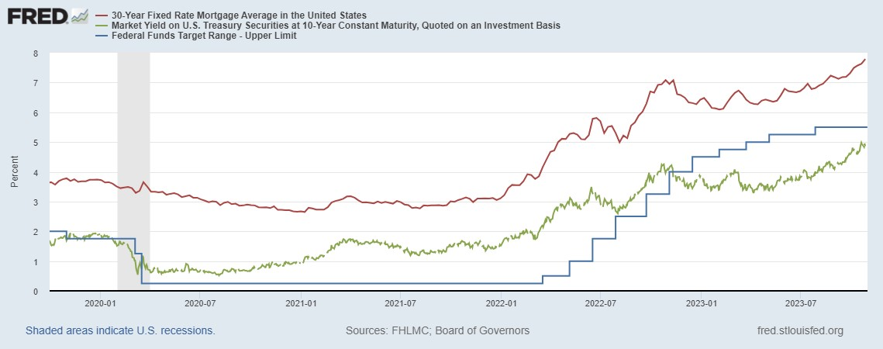
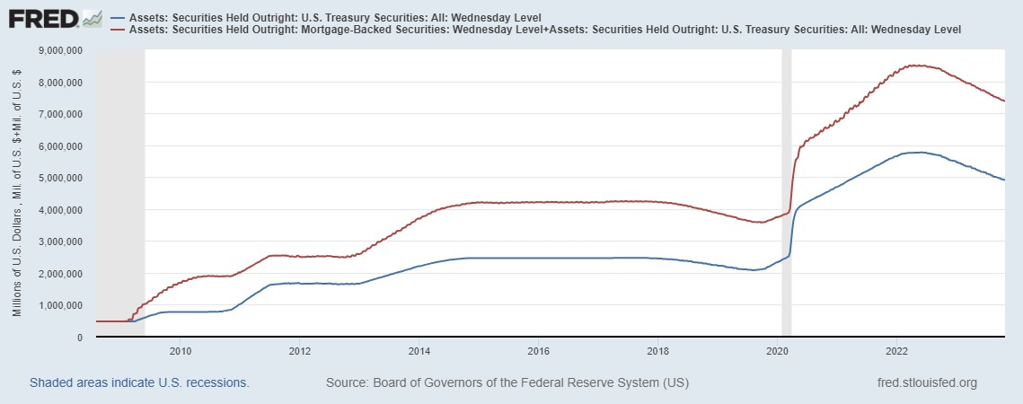
Policy Effects: Monetary
2020-2/2022: policy interest rate at zero, new round of quantitative easing.
3/2022-present: most rapid increase in interest rates since Paul Volcker

Slide 41
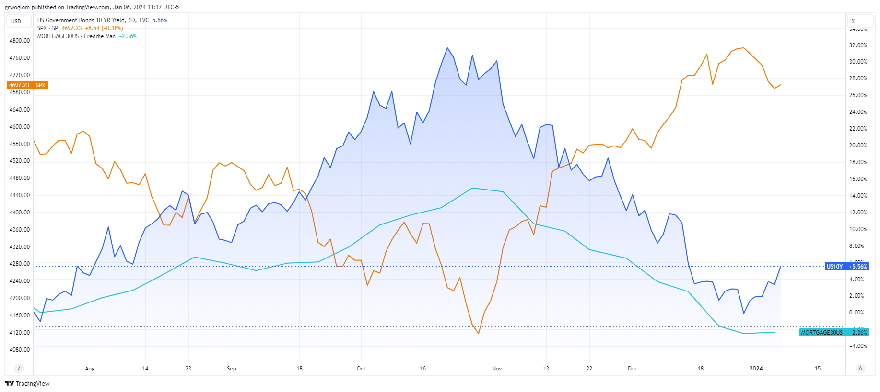
What Happened on 11/1?

Slide 42
Not Much: Changes in the Policy Statement

Slide 43
Fed’s Evolving Views on the Economy
November Survey of Professional Forecasters very similar outlook
Austin Goolsbee, President of the Chicago Fed. The economy is on a “golden path” and will achieve the “mother of all soft landings.”
How did this happen?

Slide 44
Inflation and Expectations of Inflation

Slide 45
Volcker 1980 Disinflation

Slide 47
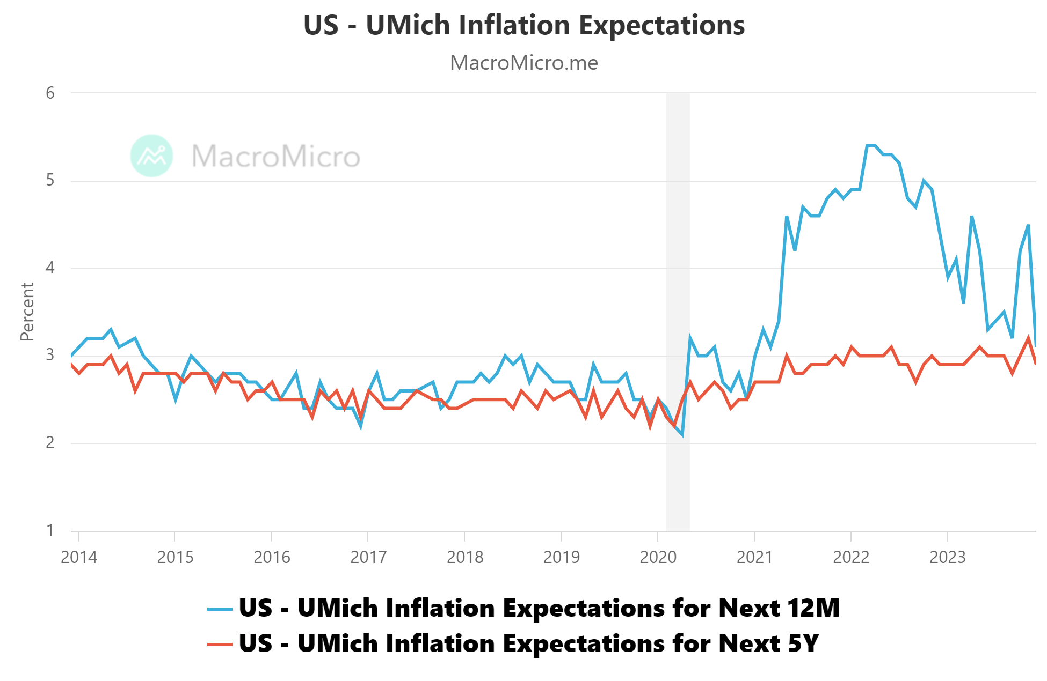
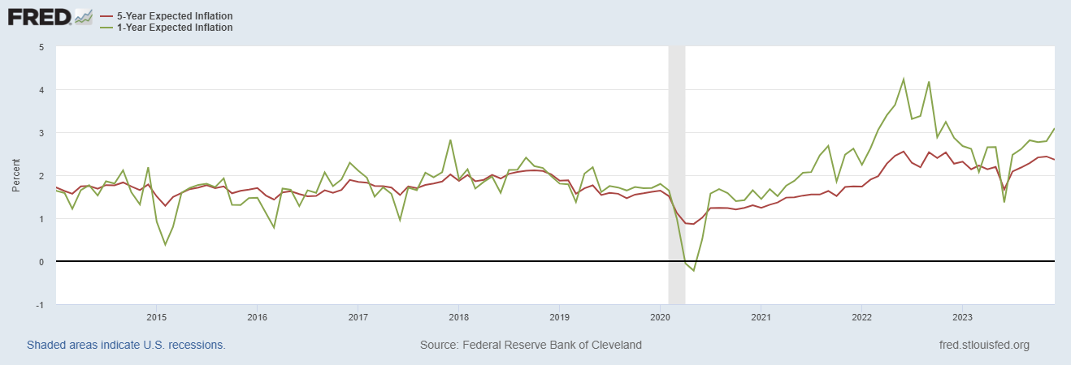
Long-Term Inflation Expectations Remained “Well Anchored”

Slide 48
What will the Fed Do?
Current and Pending Developments:
Friday’s jobs report was pretty strong.
Eurozone Inflation rose from 2.4 to 2.9% yesterday.
Budget deal over the weekend.
Thursday, 8:30 CPI inflation report which is forecasted to show modest increase driven by increases in rents.
January 30/31 next Fed meeting

Slide 49
If the Fed Sees this, What Should They Do?

Slide 50
Here is What Wall Street Thinks

Slide 51
But, Wait Till the Next Meeting in march!

Slide 52
Greenhouse Gas Emissions 1990-2019
Source: IPCC
Notes:
https://www.ipcc.ch/report/ar6/wg3/ Summary for Policymakers Figure SPM.1

Slide 53
Want to Learn More?
https://sites.google.com/view/macro-current-issues/home

Slide 54
Let’s Hear from You!
Geoffrey Woglom grwoglom@amherst.edu
Contact NEED: Info@NEEDEcon.org
Submit a testimonial: www.NEEDEcon.org/testimonials.php
Support NEED: www.NEEDEcon.org/donate.php

